Slide 1
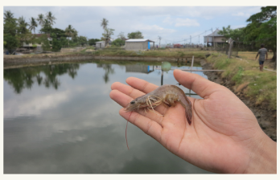
Prediksi Mikroorganisme pada Tambak Udang berbasis Neural Network
Muhammad Wafiq Kamaluddin (2210181042)
Advisor 1 :
Dr. Setiawardhana, S.T, M.T.
NIP. 197708242 00501 1 001
Advisor 2 :
Dr. Eng. Bima Sena Bayu Dewantara, S.ST, M.T.
NIP. 197612151 99903 1 003
Advisor 3 :
Dr. Eng. Agus Indra Gunawan, S.T, M.Sc
NIP. 197608212 00112 1 002

Slide 2
Outline
01
02
03
04
05
06
Background of The Study
Purpose of The Study
Problem Formulation
Scope and Limitation
Review of Literature
System Design and Progress

Slide 3
Background of The Study
In aquaculture, especially shrimp ponds, we need to pay attention to the environment where the cultivation is in order to obtain maximum result. Water quality is one of the most important things to pay attention to. In fact, the most important factor in water quality is the oxygen content, which affects the pH value. Often this level is influenced by aquatic bio-organisms, especially algae. Algae monitoring can be done by looking at the color of the water. This is where the idea for the study of water quality came from. It is hoped that this tool will be able to monitor algae as in a lab test

Slide 4
Purpose
Creating a tool to record data on samples
Create a prediction system based on recorded data

Slide 5
Problem formulation
How to create device for data sensing and collecting
How to make good model for predict the sample

Slide 6
Scope and Limitation
Sample is conditioned data whose concentration level is known.
Model is created from the data recorded from the device

Slide 7
Literature review
A. I. Gunawan, B. S. B. Dewantara, A. E. Pratama, I. Puspitasari, T. A. Setya. (2019). A Study for Estimation of Bio Organism Content on Aquaculture Pond Based on Image Color and Light Intensity. International Electronics Symposium on Engineering Technology and Applications (IES-ETA). Surabaya, Indonesia, : doi:10.1109/ELECSYM.2019.8901544.
O. Meiyanto, A. I. Gunawan, dan B. S. B. Dewantara. (2021, November). Studi Analisis Konsentrasi Warna Pada Cairan Pewarna Makanan Dengan Metode Pengukuran Optical Density. Briliant, Hal. 710-725.

Slide 8
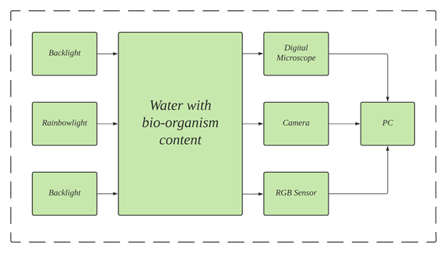
System Design

Slide 9
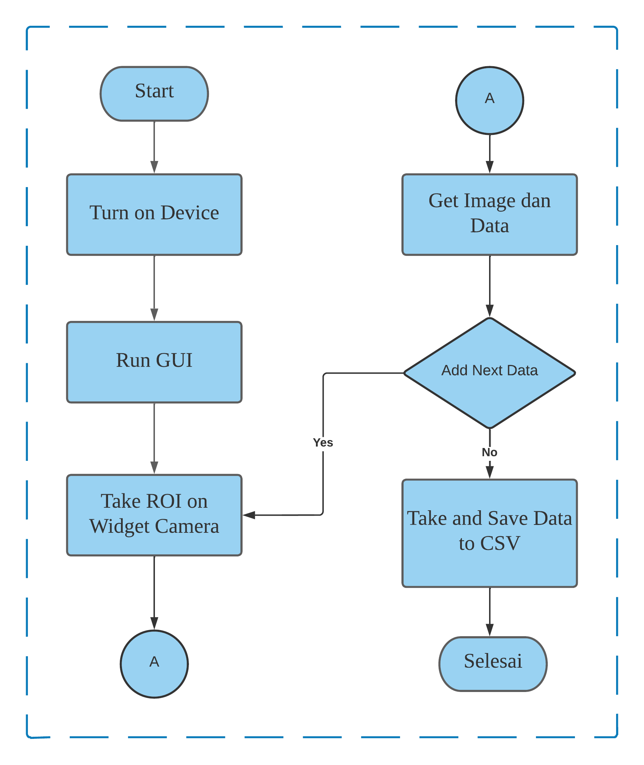
Flowchart
and
End

Slide 10
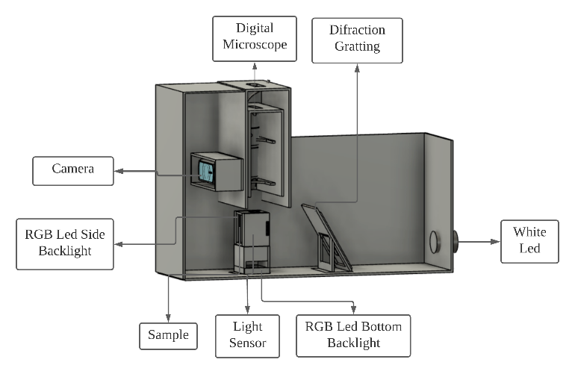
Prototype Design

Slide 11
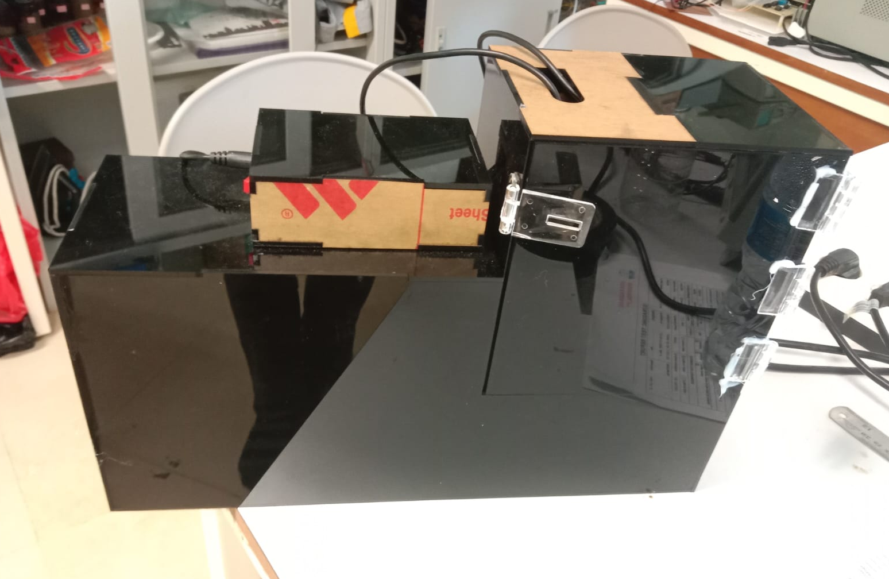
Prototype

Slide 12
Data

Slide 13
Water

Slide 16
Single Food Coloring

Slide 17
Sample Composition
Concentration | Composition
0 % Food Colorant | 4 ml air
5 % Food Colorant | 0.2 ml Food Colorant + 3.8 ml water
10 % Food Colorant | 0.4 ml Food Colorant + 3.6 ml water
25 % Food Colorant | 1 ml Food Colorant + 3 ml water
50 % Food Colorant | 2 ml Food Colorant + 2 ml water
100 % Food Colorant | 4 ml Food Colorant

Slide 18
Single Red Colorant

Slide 21
Single Green Colorant

Slide 24
Single Blue Colorant

Slide 27
Double Food Coloring Mixture

Slide 28
Sample Composition
Concentration | Composition
100 % First Colorant 0 % Second Colorant | 4 ml Second Colorant
80 % First Colorant 20 % Second Colorant | 0.8 ml First Colorant + 3.2 ml Second Colorant
60 % First Colorant 40 % Second Colorant | 1.6 ml First Colorant + 2.4 ml Second Colorant
40 % First Colorant 60 % Second Colorant | 2.4 ml First Colorant + 1.6 ml Second Colorant
20 % First Colorant 80 % Second Colorant | 3.2 ml First Colorant + 0.8 ml Second Colorant
0 % First Colorant 100 % Second Colorant | 4 ml First Colorant

Slide 29
Red and Green

Slide 32
Red and Blue

Slide 35
Green and Blue

Slide 38
Triple Food Coloring Mixture

Slide 39
Sample Composition
Concentration | Composition
20 % Red Colorant 60 % Green Colorant 20 % Blue Colorant | 0.8 ml Red Colorant + 2.4 ml Green Colorant + 0.8 ml Blue Colorant
20 % Red Colorant 40 % Green Colorant 40 % Blue Colorant | 0.8 ml Red Colorant + 1.6 ml Green Colorant + 1.6 ml Blue Colorant
20 % Red Colorant 20 % Green Colorant 60 % Blue Colorant | 0.8 ml Red Colorant + 0.8 ml Green Colorant + 2.4 ml Blue Colorant
40 % Red Colorant 40 % Green Colorant 20 % Blue Colorant | 1.6 ml Red Colorant + 1.6 ml Green Colorant + 0.8 ml Blue Colorant
40 % Red Colorant 20 % Green Colorant 40 % Blue Colorant | 1.6 ml Red Colorant + 0.8 ml Green Colorant + 1.6 ml Blue Colorant
60 % Red Colorant 20 % Green Colorant 20 % Blue Colorant | 2.4 ml Red Colorant + 0.8 ml Green Colorant + 0.8 ml Blue Colorant
33 % Red Colorant 33 % Green Colorant 33 % Blue Colorant | 1.3 ml Red Colorant + 1.3 ml Green Colorant + 1.3 ml Blue Colorant

Slide 40
Red (20 %) Green (20 %) and Blue(60 %)

Slide 41
Image Result

Slide 42
Image Result

Slide 43
Red (40 %) Green (40 %) and Blue(20 %)

Slide 44
Image Result

Slide 45
Image Result

Slide 46
ANN

Slide 47
ANN Model and Result

Slide 48
Model
No | Parameter | Value
1. | Number of neurons in the input layer | 15
2. | Number of hidden layers | 3
3. | Number of neurons in the output layer | 3
4. | Epoch | 250
5. | Learning rate | 0,0004
6. | Normalization | yes

Slide 49
Result
No | Sample Concentration Content (%)
 | Actual |  |  | Prediction |  |  | Absolute error
 | R | G | B | R | G | B | R | G | B
1. | 0 | 0 | 0 | -2.16 | 0.25 | 1.03 | 2.16 | 0.25 | 1.03
2. | 0 | 0 | 100 | -0.31 | 1.16 | 101.04 | 0.31 | 1.16 | 1.04
3. | 20 | 80 | 0 | 12.97 | 81.67 | -1.90 | 7.03 | 1.67 | 1.90
4. | 0 | 60 | 40 | -3.02 | 36.32 | 65.39 | 3.02 | 23.68 | 25.39
5. | 80 | 0 | 20 | 65.55 | -6.96 | 14.65 | 14.45 | 6.96 | 5.35
6. | 40 | 40 | 20 | 39.18 | 38.59 | 21.16 | 0.82 | 1.41 | 1.16
7. | 33.3 | 33.3 | 33.3 | 33.05 | 30.17 | 31.76 | 0.25 | 3.13 | 1.54
8. | 20 | 0 | 0 | 18.76 | 0.19 | -0.22 | 1.24 | 0.19 | 0.22
9. | 0 | 20 | 0 | 0.05 | 17.21 | -0.09 | 0.05 | 2.79 | 0.09
10. | 0 | 0 | 10 | 1.13 | -1.04 | 12.93 | 1.13 | 1.04 | 2.93
No | Absolute error |  |  | Sample Error
 | R | G | B
1 | 2.16 | 0.25 | 1.03 | 1.15
2 | 0.31 | 1.16 | 1.04 | 0.83
3 | 7.03 | 1.67 | 1.90 | 3.54
4 | 3.02 | 23.68 | 25.39 | 17.37
5 | 14.45 | 6.96 | 5.35 | 8.92
6 | 0.82 | 1.41 | 1.16 | 1.13
7 | 0.25 | 3.13 | 1.54 | 1.64
8 | 1.24 | 0.19 | 0.22 | 0.55
9 | 0.05 | 2.79 | 0.09 | 0.98
10 | 1.13 | 1.04 | 2.93 | 1.70
Mean Error |  |  |  | 3.78

Slide 50
Model
No | Parameter | Nilai
1. | Number of neurons in the input layer | 15
2. | Number of hidden layers | 15
3. | Number of neurons in the output layer | 3
4. | Epoch | 300
5. | Learning rate | 0,001
6. | Normalization | No

Slide 51
Result
No | Sample Concentration Content (%)
 | Actual |  |  | Prediction |  |  | Absolute error
 | R | G | B | R | G | B | R | G | B
1. | 0 | 0 | 0 | -4.17 | 3.46 | -0.30 | 4.17 | 3.46 | 0.30
2. | 0 | 0 | 100 | -4.44 | -0.22 | 96.55 | 4.44 | 0.22 | 3.45
3. | 20 | 80 | 0 | 18.98 | 83.83 | 1.31 | 1.02 | 3.83 | 1.31
4. | 0 | 60 | 40 | -10.98 | 21.52 | 68.48 | 10.98 | 38.48 | 28.48
5. | 80 | 0 | 20 | 76.70 | -0.70 | 17.75 | 3.30 | 0.70 | 2.25
6. | 40 | 40 | 20 | 40.71 | 40.92 | 21.41 | 0.71 | 0.92 | 1.41
7. | 33.3 | 33.3 | 33.3 | 26.52 | 19.19 | 40.35 | 6.78 | 14.11 | 7.05
8. | 20 | 0 | 0 | 14.65 | 0.47 | 0.53 | 5.35 | 0.47 | 0.53
9. | 0 | 20 | 0 | -0.03 | 16.22 | -1.54 | 0.03 | 3.78 | 1.54
10. | 0 | 0 | 10 | -3.08 | 0.65 | 11.48 | 3.08 | 0.65 | 1.48
No | Absolute error |  |  | Sample Error
 | R | G | B
1 | 4.17 | 3.46 | 0.30 | 2.64
2 | 4.44 | 0.22 | 3.45 | 2.70
3 | 1.02 | 3.83 | 1.31 | 2.05
4 | 10.98 | 38.48 | 28.48 | 25.98
5 | 3.30 | 0.70 | 2.25 | 2.08
6 | 0.71 | 0.92 | 1.41 | 1.01
7 | 6.78 | 14.11 | 7.05 | 9.32
8 | 5.35 | 0.47 | 0.53 | 2.12
9 | 0.03 | 3.78 | 1.54 | 1.78
10 | 3.08 | 0.65 | 1.48 | 1.74
Mean Error |  |  |  | 5.14

Slide 52
Conclusion
Prototype is already be used for monitoring and retrieving data
The data obtained from food colorant have appropriate values ​​between the concentration and the graphic form of the single red and green colorant. Meanwhile, for the blue colorant and the mixed colorant, the data obtained is still not in accordance with the graphic form, which has a difference with the number of concentration settings.
The first model with a simple layer architecture and using normalization has better predictive results than the model with a complex layer architecture with an error value of 3.78 compared to 5.14.

Slide 53
Thankyou

